Slide 1
Registering to vote
US Citizen older than 18 on November 3rd?
Will you have lived in NC 30 days before November 3rd?
Not serving terms of a felony sentence (including probation & parole)?
Voter Registration Deadline: October 9, 2020
www.ncsbe.gov/registering/how-register

Slide 2
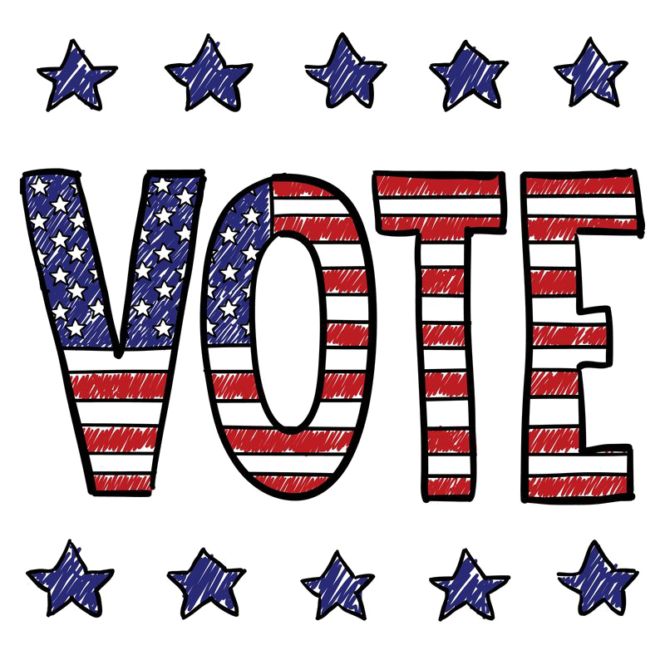
Voting by mail (absentee ballot)
2 Step Process
Request your ballot
Return your ballot
VOTE EARLY
October 15 - 31
6:30 am – 7:30 pm
Vote at any early polling site
Mon-Fri: 8 am-7:30 pm
Saturday: 8 am - 1 pm
Sunday: 1 pm – 6 pm
October 31: 8 am – 3 pm
Vote on election day
Check your polling site and retrieve your sample ballot:
https://vt.ncsbe.gov/RegLkup/

